Slide 1


Subject Name :SOFTWARE TESTING Presentation Title: CONCEPTS OF SOFTWARE TESTING
JEPPIAAR INSTITUTE OF TECHNOLOGY
“Self-Belief | Self Discipline | Self Respect”
Department of Computer Science and Engineering
Team Members:
Students Name Reg.No:
1.Arun terrance 210617104006
2.benninton 210617104009
3.mansoor 210617104030
4.nithesh 210617104040
5.shiva 210617104050
6.shrinath 210617104051

Slide 2
Introduction on Testing Testing Methodology Testing optimization Testing Tools Testing Management Process Need for testing Testing Artifacts Testing Quality Metrices Testing life cycle
OBJECTIVE

Slide 3
INTRODUCTION ON TESTING
Software testing is defined as an activity to check whether the actual results match the expected results and to ensure that the software system is Defect free.
Software testing also helps to identify errors, gaps or missing requirements in contrary to the actual requirements. It can be either done manually or using automated tools.
In simple terms, Software Testing means Verification of Application Under Test (AUT).

Slide 4
TESTING METHODOLOGIES
Typically Testing is classified into three categories.
Functional Testing
1.Unit Testing
2.Integration Testing
Non-Functional Testing
Performance Testing
Maintenance
1.Regression
2.Maintenance

Slide 5
TEST OPTIMIZATION
It significantly increasing the efficiency of testing processes.
The process of making testing process quicker not compromising on its accuracy is called Optimization of Testing Process.
The build will be completed at reasonable faster pace than traditional approach.
The test optimization process can be done by making changes in how the test cases are run such as execute the tests which cover changes in the build or run tests an optimal order.

Slide 6
HOW TO OPTIMIZE TESTS
Starting Testing Process in Early Phase of Software Development
Well Planned Testing Process
Using Effective Testing Methods
Using Proper Testing Tools during Software Development
Choose suitable Software Development Methodology
Conduct Reviews
Efficient allocation and usage of Resources
Deploy Proper Testing Environment

Slide 7
SOFTWARE TESTING TOOLS
Test Management Tool
Automated Testing Tools
Cross-browser Testing Tools
Load Testing Tools
Defect Tracking Tools
Mobile Testing Tools
API Testing Tools
Security Testing Tools
CSS Validator Tool

Slide 8











SOME POPULAR TESTING TOOLS

Slide 9
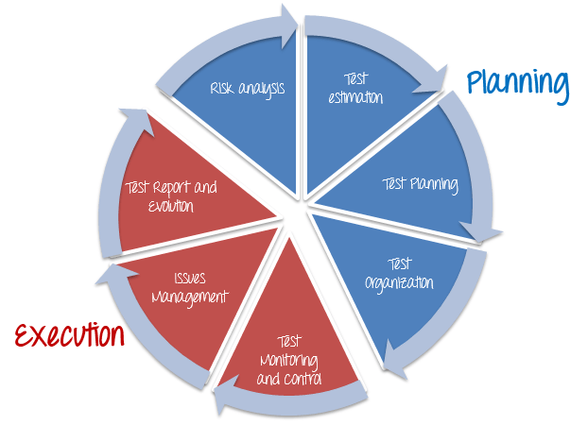
TEST MANAGEMENT PROCESS
There are two main Parts of Test Management Process: -
1.Planning
Risk Analysis
Test Estimation
Test Planning
Test Organization
2.Execution
Test Monitoring and Control
Issue Management
Test Report and Evaluation

Slide 10
NEED FOR TESTING
1.Software testing is really required to point out the defects in development process
2.To ensure customer finds the organization reliable and their satisfaction in the application is maintained.
3.It is very important to ensure the Quality of the product. Quality product delivered to the customers helps in gaining their confidence.
4.Testing is required for an effective performance of software application or product.
5. poor quality of software may result in lack of adoption of the product and this may result in losses which the business may not recover from.

Slide 11
TESTING ARTIFACTS
Test Artifacts are documents which prepared during testing process. These documents are shared with clients, Test Managers, Team members, and other people involved in the project so that every test process are properly recorded and are transparent for all.
Different Test Artifacts
Test Strategy
Test Plan
Test Scenario
Test Case
Software Test Report

Slide 12
TESTING QUALITY METRICES
Software testing metrics are a way to measure and monitor your test activities.
How long will it take to test?
How much money will it take to test?
How bad are the bugs?
How many bugs found were fixed? reopened? closed? deferred?
How many bugs did the test team did not find?
How much of the software was tested?
Will testing be done on time? Can the software be shipped on time?
How good were the tests? Are we using low-value test cases?
What is the cost of testing?
Was the test effort adequate? Could we have fit more testing in this release?

Slide 13
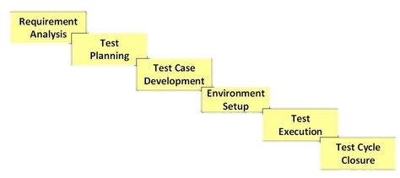
TESTING LIFE CYCLE
1.During this phase, test team studies the requirements from a testing point of view
2. A Senior QA manager will determine effort and cost estimates for the project
3. This phase involves the creation, verification and rework of test cases & test scripts
4. Test environment decides the software and hardware conditions under which a work product is tested.
5. During this phase, the testers will carry out the testing based on the test plans and the test cases prepared
6. Testing team will meet, discuss and analyze testing artifacts to identify strategies that have to be implemented in the future

Slide 14


